Slide 1
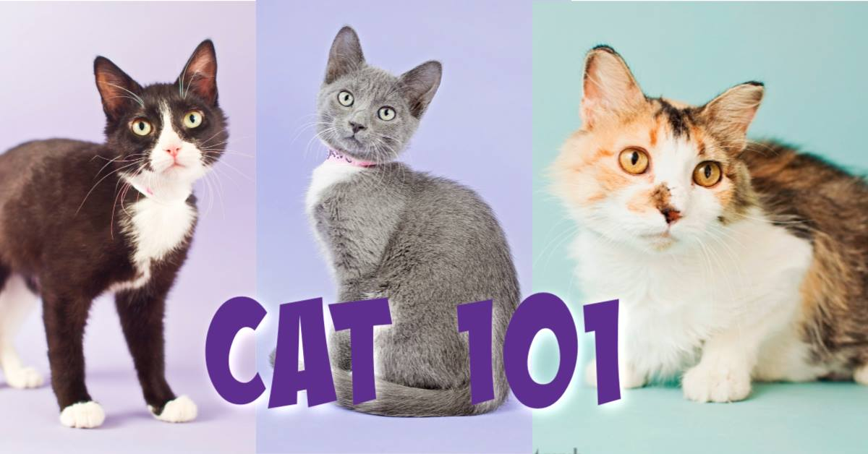

Slide 2
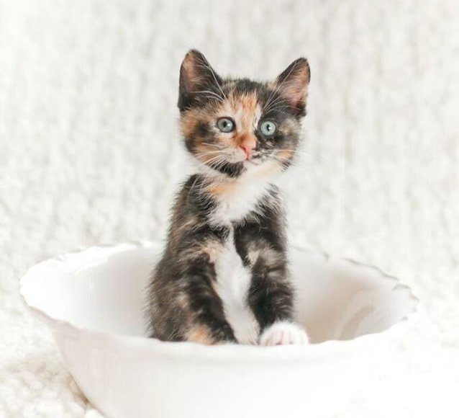
Welcome to Cat 101!
What brings you here today?

Slide 3
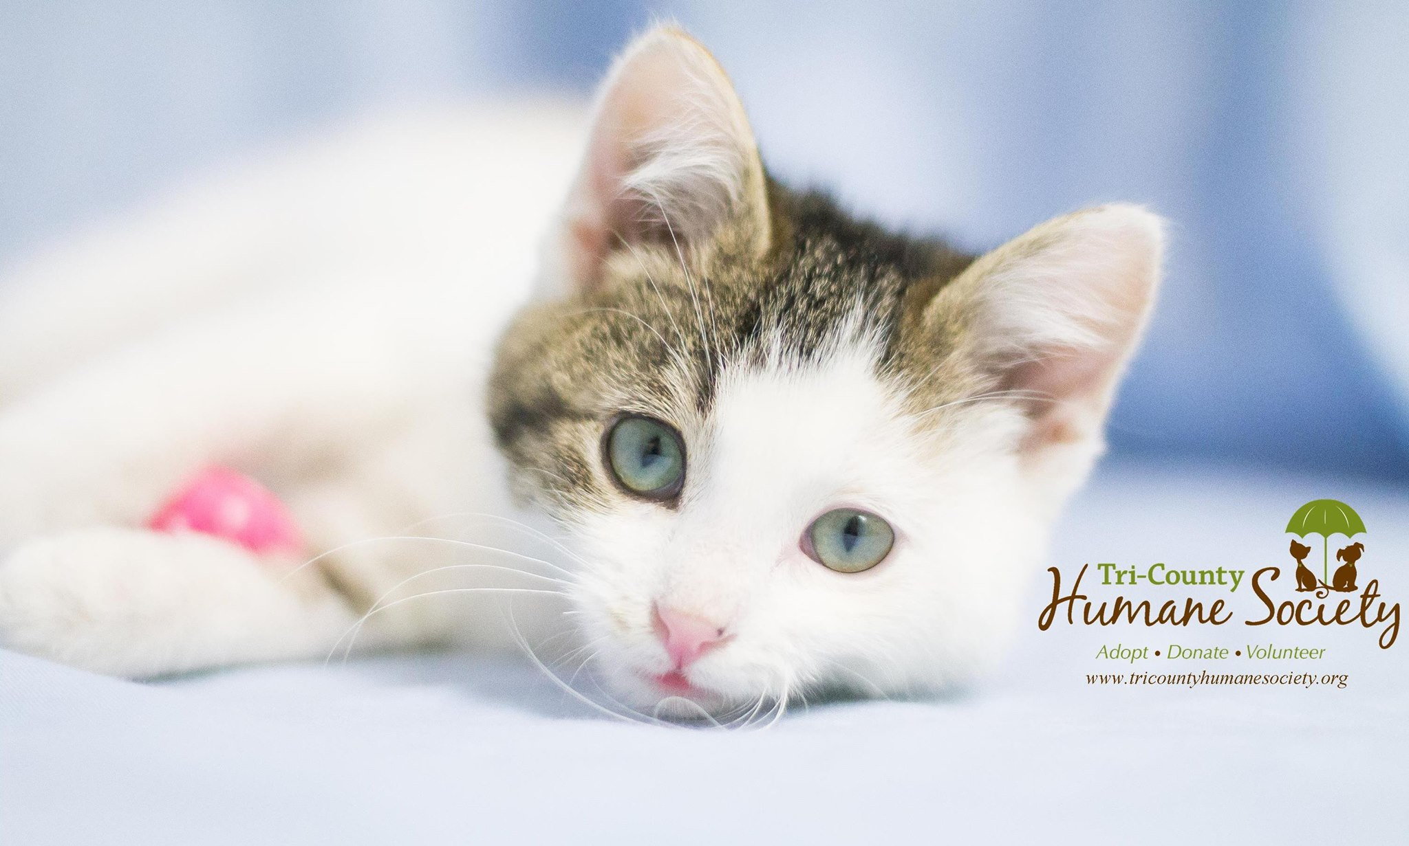
Who are we?
TCHS Mission: We believe in the human-animal bond and exist to support Central MN by practicing and promoting quality adoption services and education programs.
We take in anywhere from 3000-5000 animals per year!
In 2017, we had a 93.44% placement rate
Rose Hegerle - Certified Veterinary Technician
Kate Kompas – Volunteer and Events Coordinator

Slide 4
Cat Stats
Approximately 3.2 million cats enter U.S. animal shelters annually. (3.3 million dogs)
Approximately 85.8 million cats are owned in the U.S. (78 million dogs)
Approximately 35% of all U.S. households have a cat. (44% have dogs)
Pet Problems are most common reason owners rehome
  47% of rehomed dogs
  42% of rehomed cats
  Source: aspca.org

Slide 5
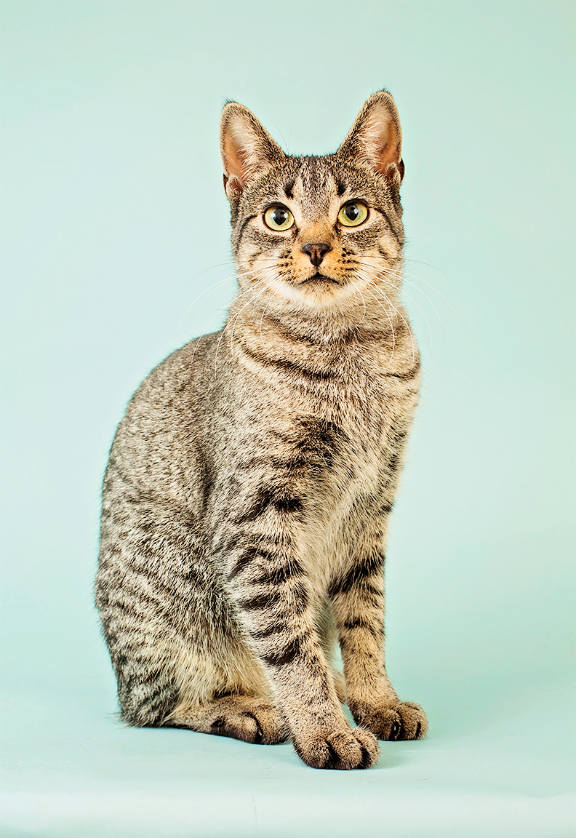
Considering adopting a cat?
Time?
Multi-Cat Household?
Adult vs. kitten?
One or Two?
Resources/Costs?
Education?
  Cat behavior
  Health needs

Slide 6
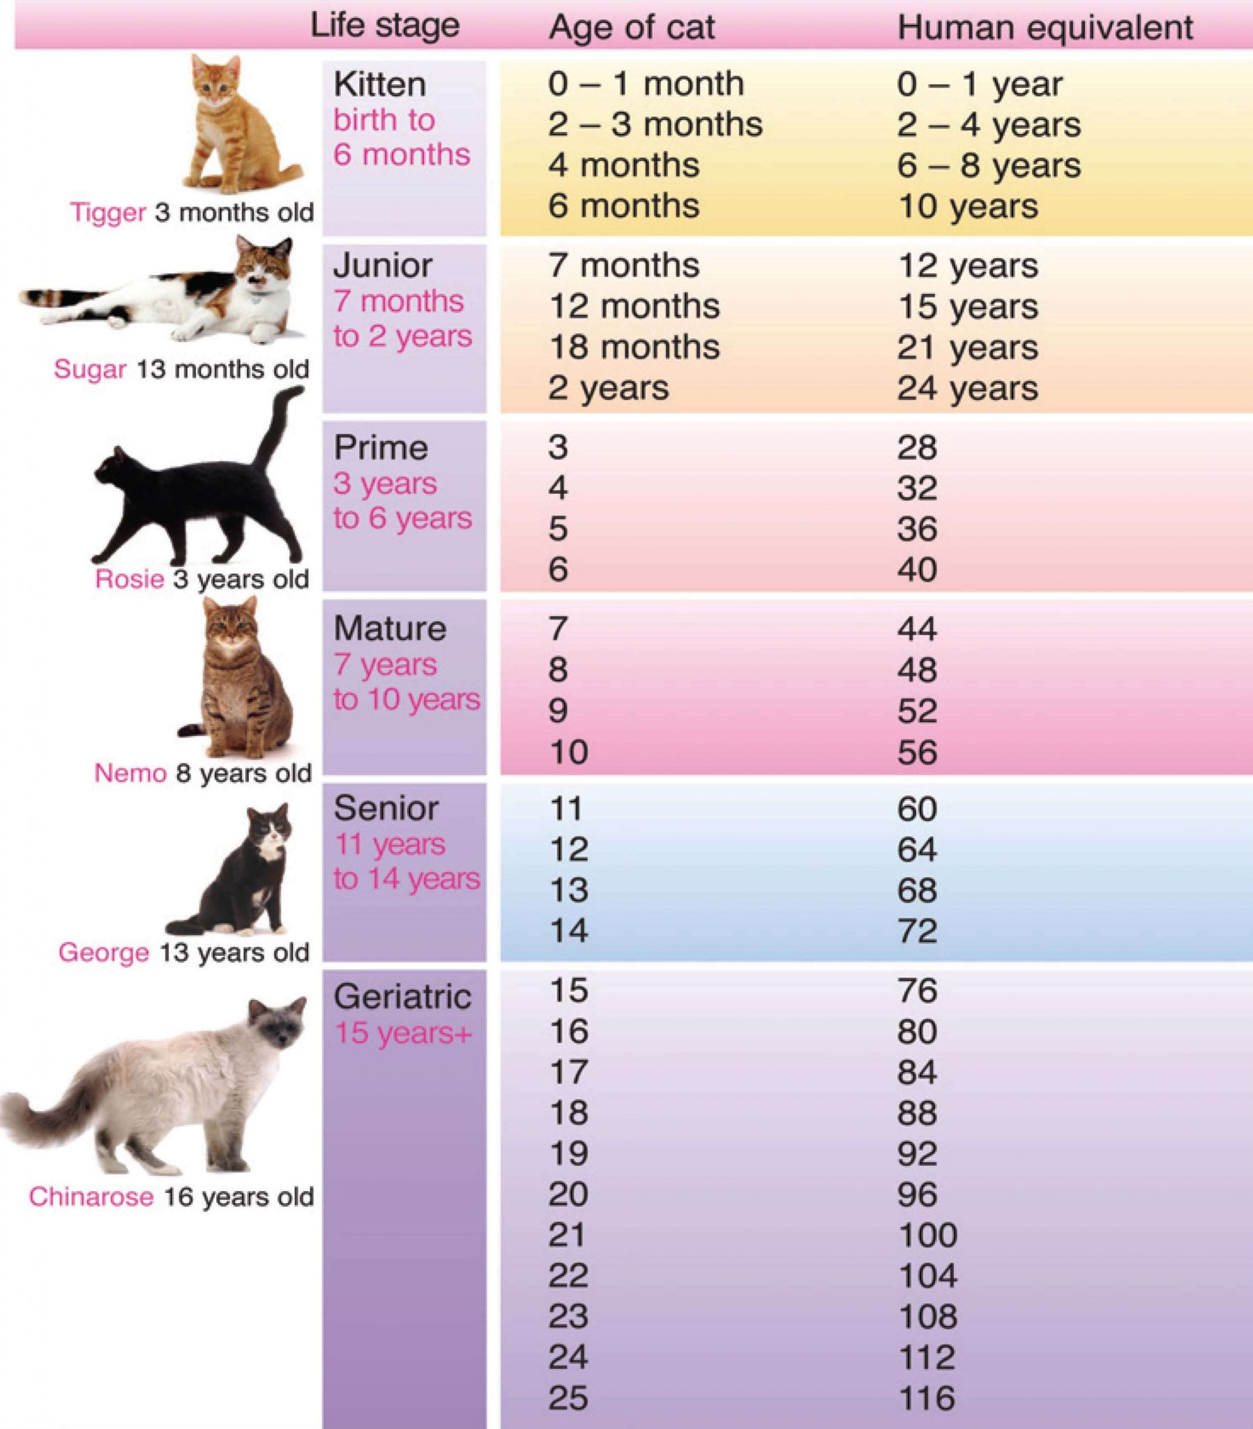
Life Stages
Kitten: Play & socialization
Junior: Sexual maturity, potential for inter-cat aggression
Prime: “Typical cat”
Mature: Decreased play
Senior: More regular check-ups
Geriatric: Golden years
Image: catfriendly.com

Slide 7
Basic Supplies
Food
Dishes
Scratching posts and cat trees
Toys
Litter box and supplies
Grooming supplies
Collar, tags, microchip
Placement is important!

Slide 8
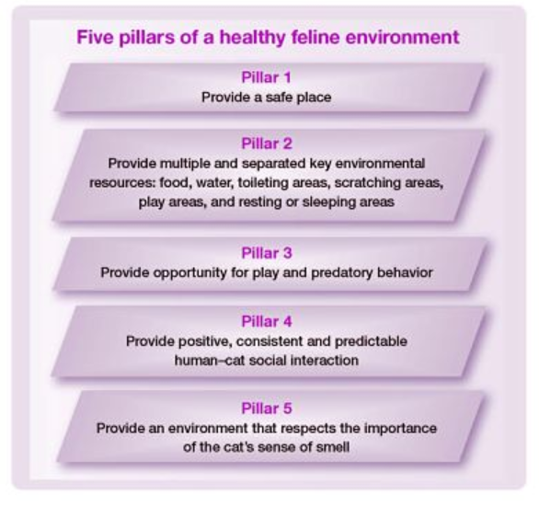
Security Items:
1. Food
2. Water
3. Toilet
4. Safe Place to Sleep
5. Familiar Territory
Image: American Association of Feline Practitioners

Slide 9

Helping Cats Find Peace and Calm
Easily stressed in unfamiliar situations
Respect need for time to adjust
Desensitization (carrier, car, etc.)
Rewards
Senses
  Smell
  Hearing (4X more sensitive than people)
  Touch
  Sight

Slide 10
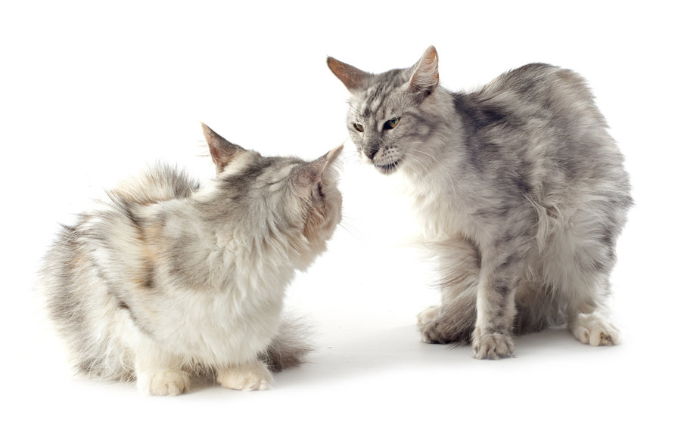
Introductions
Step 1
  Isolation
  Open carrier
  Familiar scents
Step 2
  Move food dishes near door
  Toy under the door
  Swap scents
  Open door for brief intros
  catfriendly.com

Slide 11
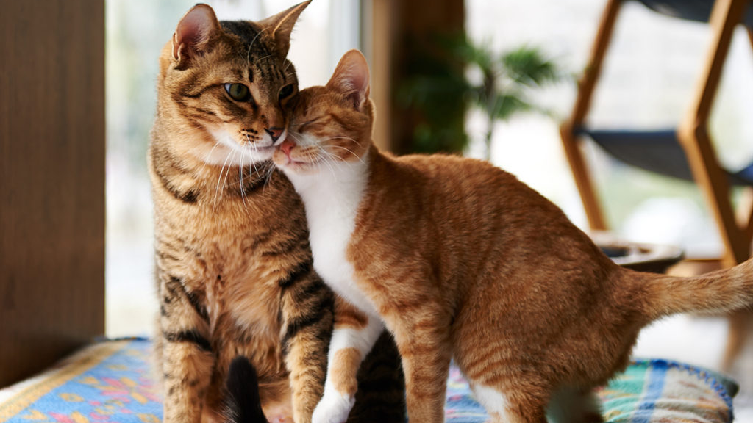
Introductions
Step 3
  Place carrier with new cat in communal areas
  Rewards
Step 4
  Allow together with supervision
  Short periods
Tips:
  Own resources
  Go back a step if there is stress
  Patience!
  Realistic expectations
  catfriendly.com

Slide 12
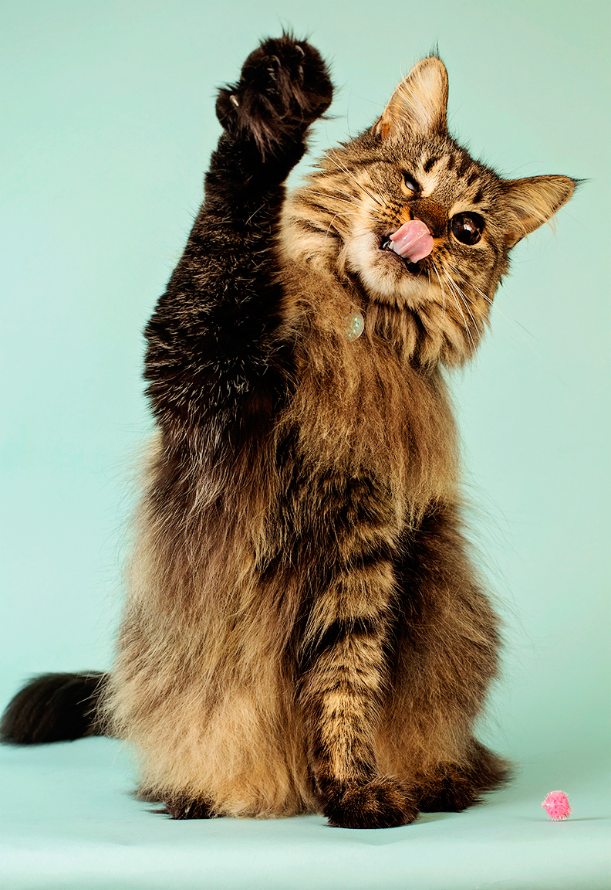
Play and Enrichment
Opportunities for play and hunt instincts
Variety
Textures that change with play
Rotate
Allow for capture (even laser)
Individual playtime
Interactive feeding/treats
Don’t use hands!
No strings!

Slide 13
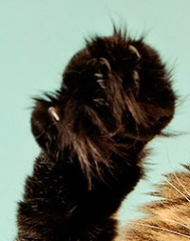
Claws
Cats are meant to have claws
  Hunting and play
  Defense
  Mark territory
Scratching is normal, healthy behavior
  Nail health
  Territory management
  Stretching
Changes in scratching behavior may indicate stress

Slide 14
Living with Claws
Trim nails
Provide appropriate resources
Enrichment and play
Respect your cat’s needs
Find the preferred scratching surfaces
  Vertical vs. horizontal
  Texture
  Size
Location!
  Near sleeping areas
  In places of scratching

Slide 15
Unwanted Scratching
Evaluate location of unwanted scratching
Place scratching post in scratching area
Rule out medical issues and stress
Inter-cat issues
It sometimes helps to place two-sided tape, tin foil, or covers to deter scratching
Declawing (amputation of bones) is not recommended
  Painful
  Long-term medical and behavioral issues

Slide 16
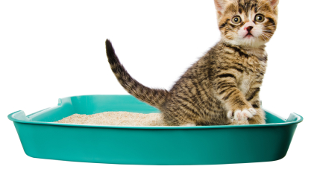
Litter Box Care
THE CAT
  Is there a medical issue? Consider the health status and age of your cat
  Multiple cats? Formula for number of boxes in home: Number of cats + 1 = MINIMUM number of boxes
THE BOX/PLACEMENT
  Box on each floor of the home- private, low traffic areas
  Away from eating areas
  At least 1.5 times the length of the cat
  Find the preferred type of litter and box
MAINTENANCE
  Scoop at least once daily
  Fully clean with warm soapy water monthly

Slide 17
DOs and DON’Ts of Litter Box Issues
DO:
Evaluate your litter box care
Rule out medical concerns
Stress-reduction
Patience
Ask for help
DON’T:
Punish cat
Assume motivation
Ignore the issue
Make snap decisions

Slide 18
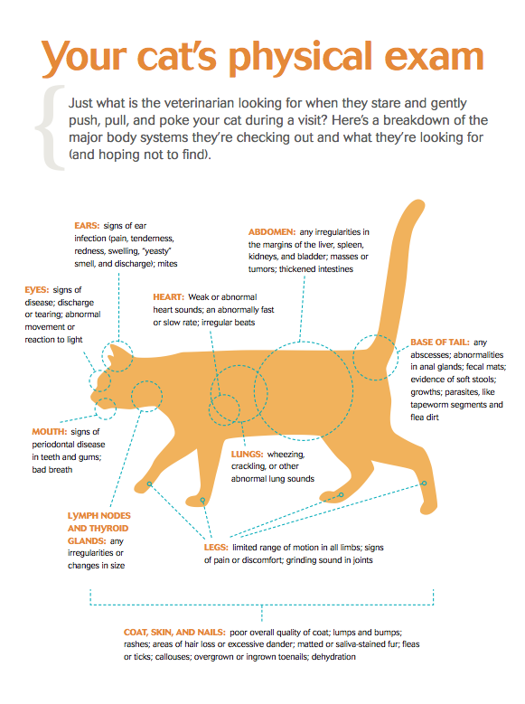
Health and Wellness
Regular check-ups and preventative care
High-quality diet- portion control
Know what’s normal for your cat!
Physical, mental, emotional health
Age-specific needs
Image: doctorspetclinic.com

Slide 19
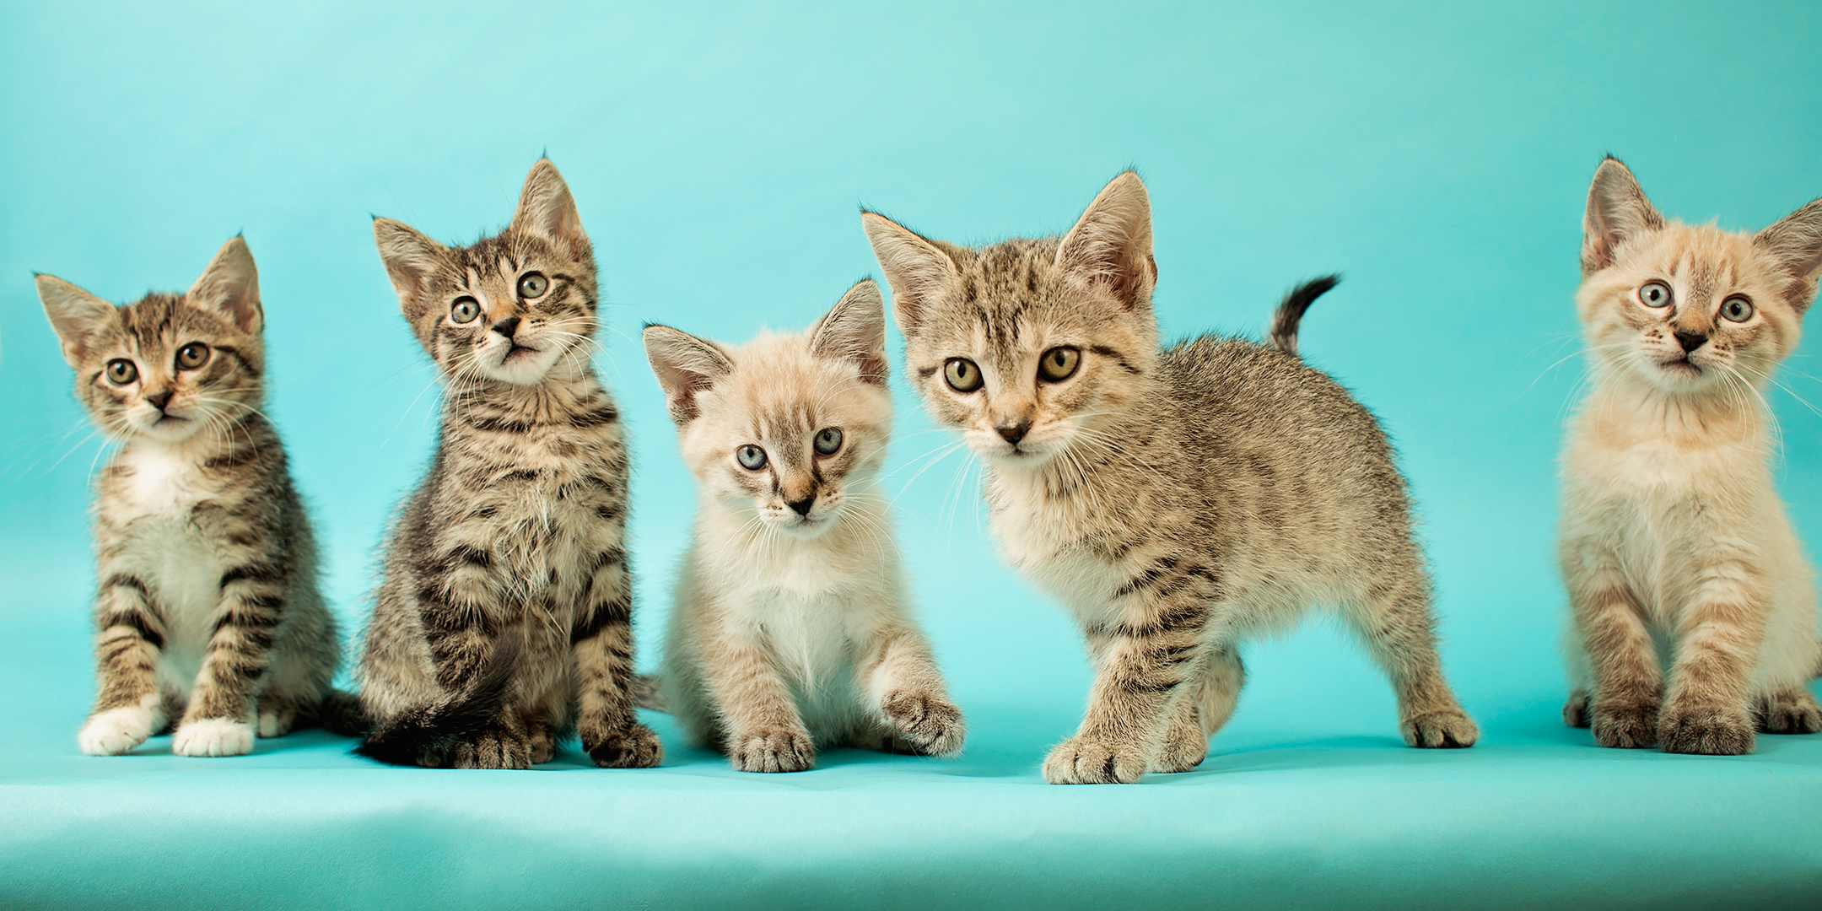
Not sure about the commitment?
FOSTER!

Slide 20
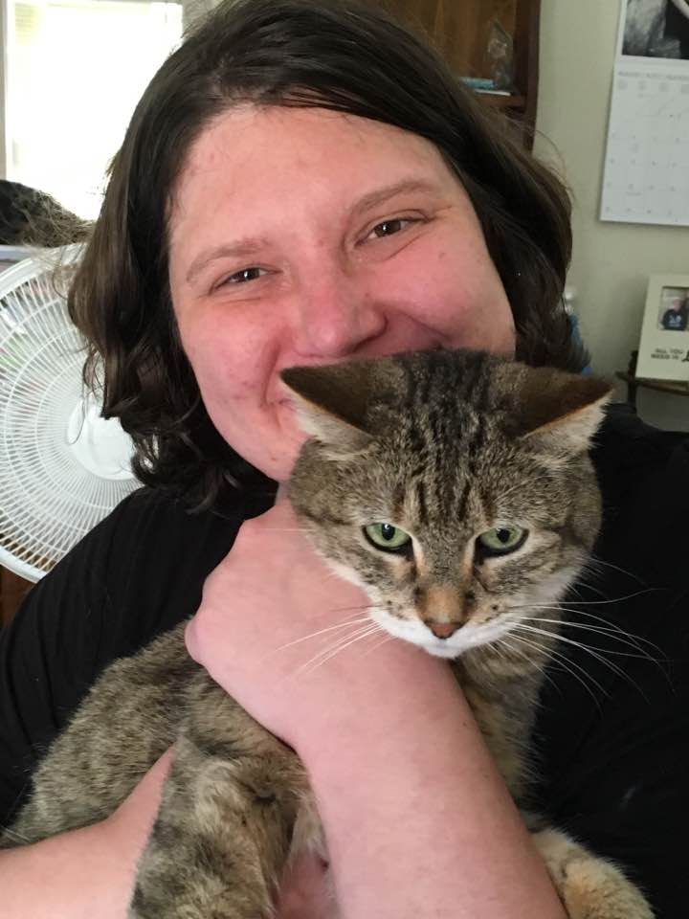
Want more hands-on cat experience?
VOLUNTEER

Slide 21
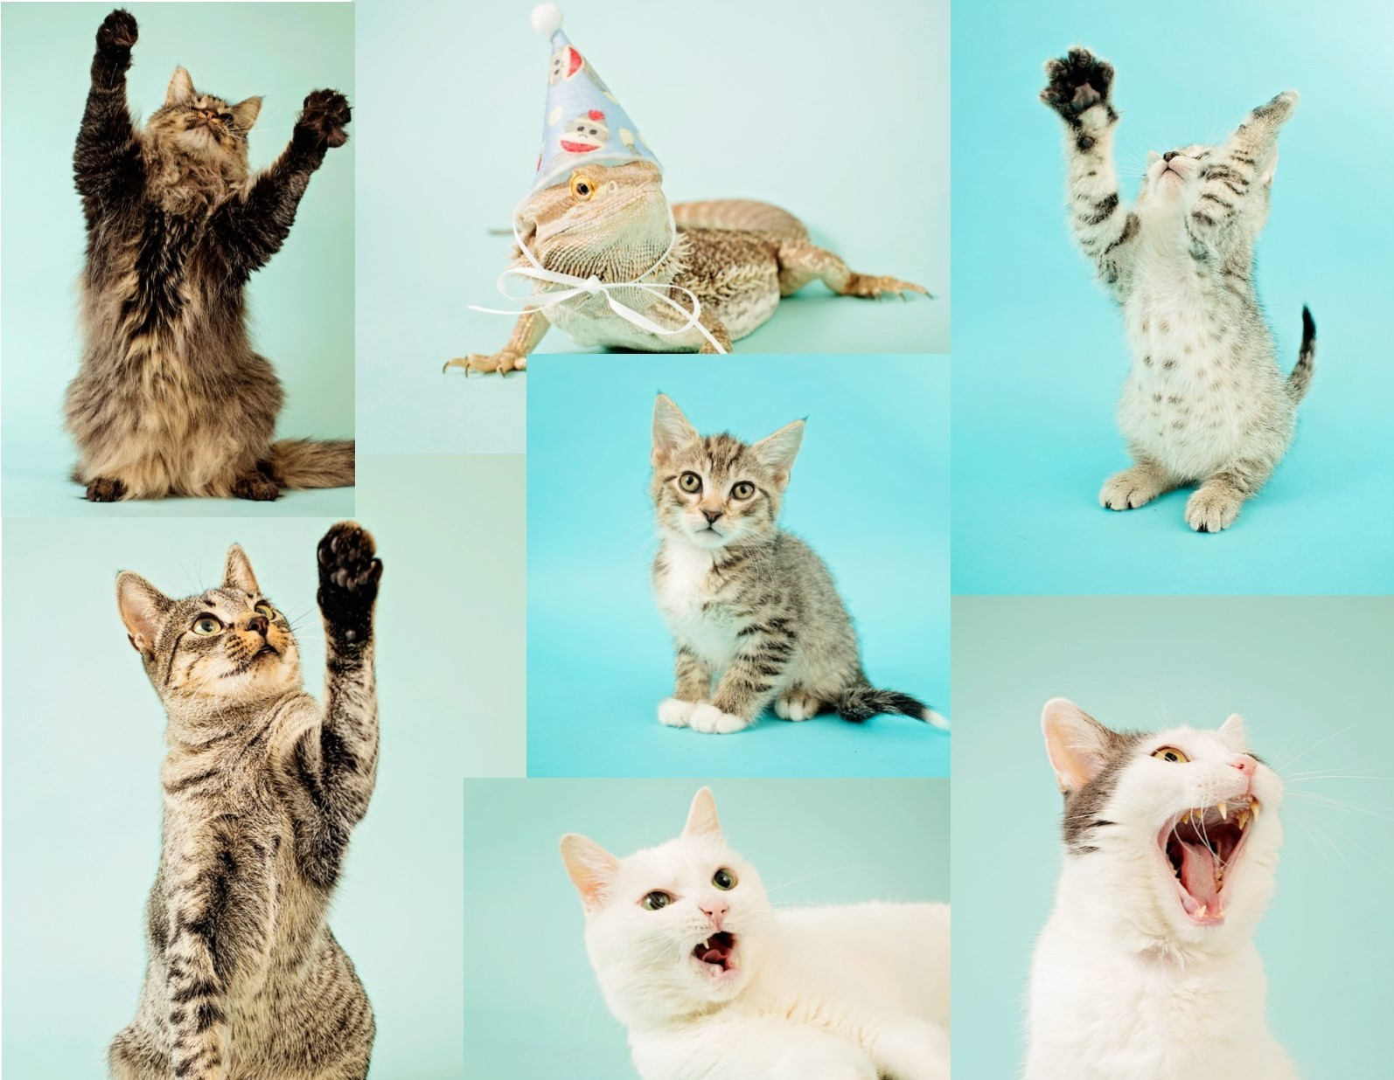
Ready for a new cat?
ADOPT

Slide 22
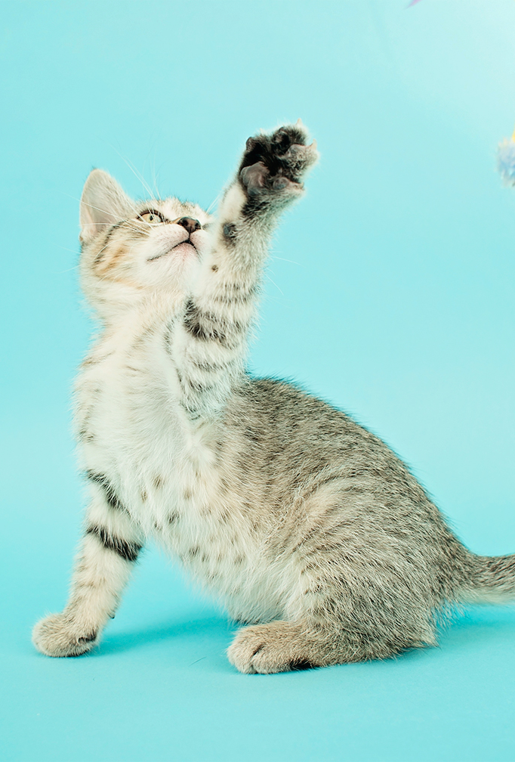
Questions?

Slide 23
Still have questions?
Lots of resources available:
Tri-County Humane Society!
  www.tricountyhumanesociety.org
  320-252-0896
American Society for the Prevention of Cruelty to Animals
  www.aspca.org
Catfriendly.com (By American Association of Feline Practitioners)

